Slide 1
Artificial Intelligence

Slide 2
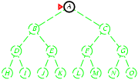
Depth-first Search
  Expand deepest unexpanded node
  Goes to the deepest level of the search tree where there are no further successors
Implementation:
  use frontier as a Stack, LIFO
  Put the expanded node at the front of the frontier
  Frontier = A

Slide 3
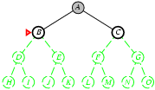
Depth-first Search
Expand deepest unexpanded node
Check if A is goal, it is not, expand A, remove A
Frontier = B,C

Slide 4
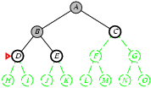
Depth-first Search
Check if B is goal, it is not, expand B, remove B
Frontier = D,E,C

Slide 5
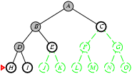
Depth-first Search
Check if D is goal, it is not, expand D, remove D
Frontier = H, I, E, C

Slide 6
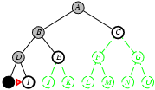
Depth-first Search
Both H and I has not successors so remove them if it is not goal
Frontier = E, C

Slide 7
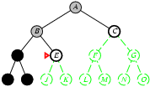
Depth-first Search
Check if E is goal, it is not, expand E, remove E
Frontier = J, K, C

Slide 8
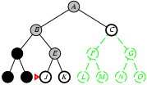
Depth-first Search
J and K do not have successors neither is any of them goal so remove them from frontier one by one
Frontier = C

Slide 9
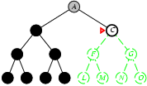
Depth-first Search
Check if C is goal, it is not, expand C, remove C
Frontier = F, G

Slide 10
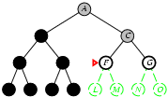
Depth-first Search
Check if F is goal, it is not, expand F, remove F
Frontier = L, M, G

Slide 11
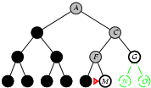
Depth-first Search
Both L, M are not goal, neither they have any successor
Remove L, M from frontier
frontier = G
Check if G is goal, it is
The search terminates

Slide 12
Properties of Depth-first Search
Complete? No: fails in infinite-depth spaces, spaces with loops
  Complete in finite state space
  Modify to avoid repeated states along path
Optimal? No, because there is chance that goal can be on other side which is closest but we explored the opposite side which is deeper and no goal or farthest goal.
Time? O(b^{m})
m=maximum depth of the search tree
terrible if the deepest level the algorithm may explore.
Space? worst case O(b*m) average case O(b*d) best case O(b)

